Slide 1
Tableau

Slide 2
Tableau Introduction
Tableau is a Business Intelligence tool for visually analyzing the data. Users can create and distribute an interactive and shareable dashboard, which depict the trends, variations, and density of the data in the form of graphs and charts. Tableau can connect to files, relational and Big Data sources to acquire and process data. The software allows data blending and real-time collaboration, which makes it very unique. It is used by businesses, academic researchers, and many government organizations for visual data analysis.

Slide 3
Tableau Features
Speed of Analysis − As it does not require high level of programming expertise, any user with access to data can start using it to derive value from the data.
Self-Reliant − Tableau does not need a complex software setup. The desktop version which is used by most users is easily installed and contains all the features needed to start and complete data analysis.
Visual Discovery − The user explores and analyzes the data by using visual tools like colors, trend lines, charts, and graphs. There is very little script to be written as nearly everything is done by drag and drop.
Blend Diverse Data Sets − Tableau allows you to blend different relational, semistructured and raw data sources in real time, without expensive up-front integration costs. The users don’t need to know the details of how data is stored.
Architecture Agnostic − Tableau works in all kinds of devices where data flows. Hence, the user need not worry about specific hardware or software requirements to use Tableau.
Real-Time Collaboration − Tableau can filter, sort, and discuss data on the fly and embed a live dashboard in portals like SharePoint site or Salesforce. You can save your view of data and allow colleagues to subscribe to your interactive dashboards so they see the very latest data just by refreshing their web browser.
Centralized Data − Tableau server provides a centralized location to manage all of the organization’s published data sources. You can delete, change permissions, add tags, and manage schedules in one convenient location.

Slide 4
Data Types
Data Type | Description | Example
STRING | Any sequence of zero or more characters. They are enclosed within single quotes. The quote itself can be included in a string by writing it twice. | 'Hello' 'Quoted' 'quote'
NUMBER | These are either integers or floating points. It is advised to round the floating point numbers while using them in calculations. | 3 142.58
BOOLEAN | They are logical values. | TRUE FALSE
DATE & DATETIME | Tableau recognizes dates in almost all formats. But in case we need to force Tableau to recognize a string as date, then we put a # sign before the data. | "02/01/2015" "#3 March 1982"

Slide 5
File Type | Extension | Purpose
Tableau Workbook | .twb | It contains information on each sheet and dashboard that is present in a workbook. It has the details of the fields, which are used in each view and the formula applied to the aggregation of the measures.It also has the formatting and styles applied. It contains the data source connection information and any metadata information created for that connection.
Tableau Packaged Workbook | .twbx | This file format contains the details of a workbook as well as the local data that is used in the analysis. Its purpose is to share with other Tableau desktop or Tableau reader users, assuming it does not need data from the server.
Tableau Data Source | .tds | The details of the connection used to create the tableau report are stored in this file. In the connection details, it stores the source type (excel/relational/sap, etc.)
Tableau Packaged Data source | .tdsx | This file is similar to the .tds file with the addition of data along with the connection details.
Tableau Data Extract | .tde | This file contains the data used in a .twb file in a highly compressed columnar data format. This helps in storage optimization. It also saves the aggregated calculations that are applied in the analysis.
Tableau Bookmark | .tbm | These files contain a single worksheet that is shared easily to be pasted into other workbooks.
Tableau Preferences | .tps | This file stores the color preference used across all the workbooks. It is mainly used for consistent look and feel across the users.

Slide 6
These three steps are −
Connect to a data source − It involves locating the data and using an appropriate type of connection to read the data.
Choose dimensions and measures − This involves selecting the required columns from the source data for analysis.
Apply visualization technique − This involves applying required visualization methods, such as a specific chart or graph type to the data being analyzed.

Slide 7
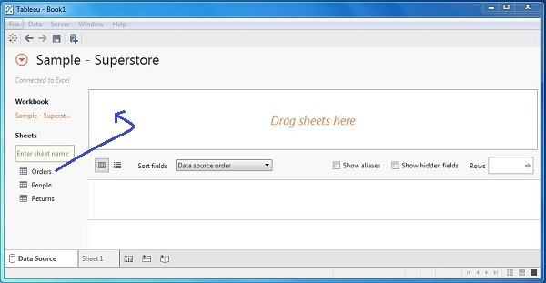
Connect to a Data Source

Slide 8
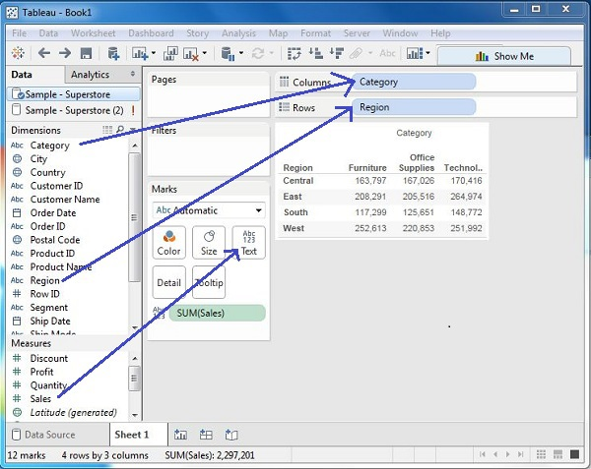
Choose the Dimensions and Measures

Slide 9
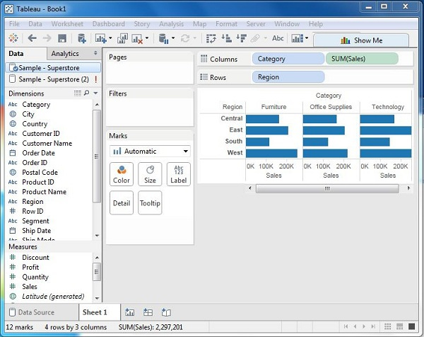
Apply Visualization Technique

Slide 10
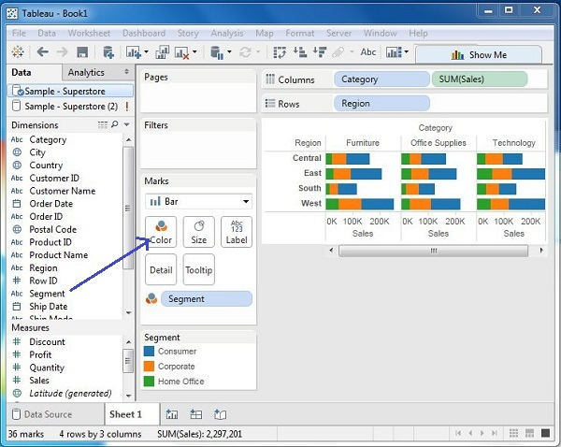
You can apply a technique of adding another dimension to the existing data. This will add more colors to the existing bar chart as shown in the following screenshot.

Slide 11
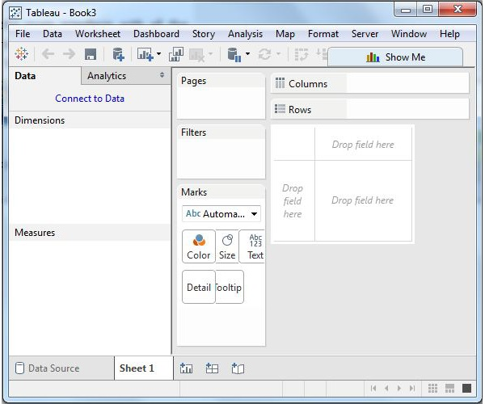
Menu Commands

Slide 12
File Menu
This menu is used to create a new Tableau workbook and open existing workbooks from both the local system and Tableau server. The important features in this menu are −
Workbook Locale sets the language to be used in the report.
Paste Sheets pastes a sheet into the current workbook, which is copied from another workbook.
Export Packaged Workbook option is used to create a packaged workbook, which will be shared with other users.

Slide 13
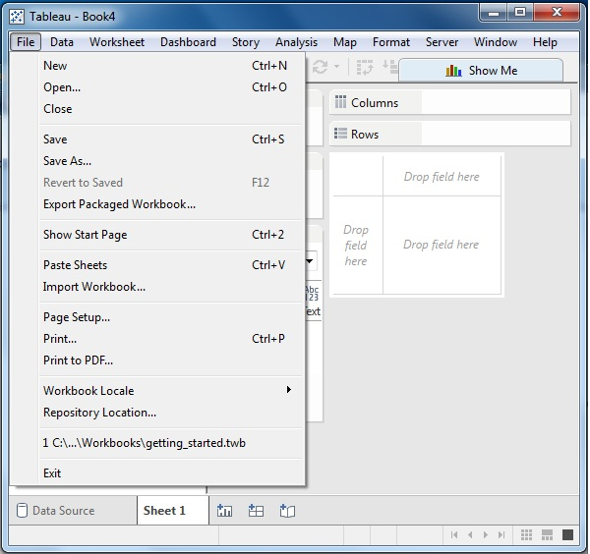

Slide 14
Data Menu
This menu is used to create new data source to fetch the data for analysis and visualization. It also allows you to replace or upgrade the existing data source.
The important features in this menu are as follows −
New Data Source allows to view all the types of connections available and choose from it.
Refresh All Extracts refreshes the data from the source.
Edit Relationships option defines the fields in more than one data source for linking.

Slide 15
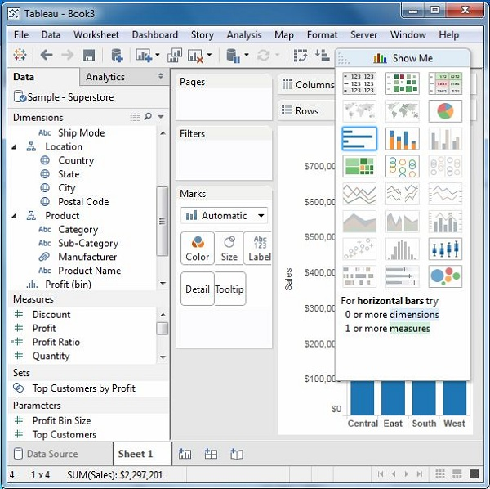
Show Me

Slide 16
Show Me with Two Fields
The relation between two fields can be visually analyzed easily by using various graphs and charts available in Show Me. In this case, we choose two fields and apply a line chart. Following are the steps −
Step 1 − Select the two fields (order date and profit) to be analyzed by holding the control key.
Step 2 − Click the Show Me bar and choose line chart.
Step 3 − Click the Mark Label button on the scrollbar.

Slide 17
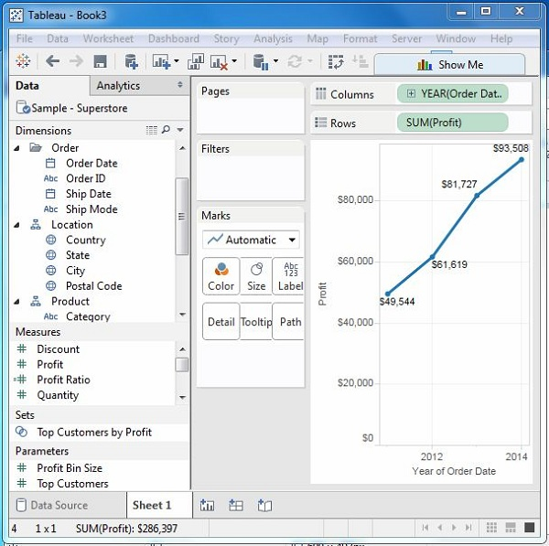
The following diagram shows the line chart created using the above steps.

Slide 18
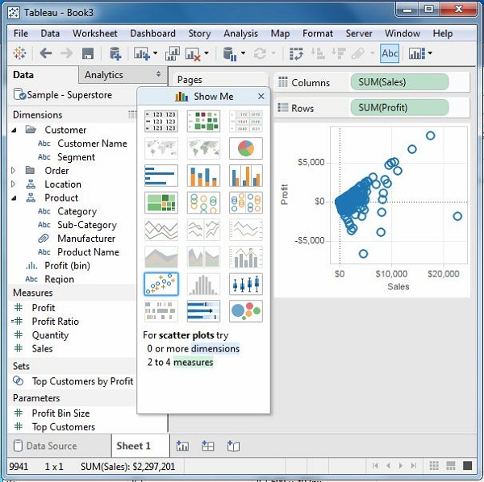
Show Me with Multiple Fields
We can apply a similar technique as above to analyze more than 2 fields. The only difference in this case will be the availability of fewer views in active form. Tableau automatically greys out the views that are not appropriate for the analysis of the fields chosen.
In this case, choose the field’s product name, customer name, sales and profit by holding down the control key. As you can observe, most of the views in Show Me are greyed out. From the active views, choose Scatter View.

Slide 19
data sources support by Tableau
Tableau can connect to all the popular data sources which are widely used. Tableau’s native connectors can connect to the following types of data sources.
File Systems such as CSV, Excel, etc.
Relational Systems such as Oracle, Sql Server, DB2, etc.
Cloud Systems such as Windows Azure, Google BigQuery, etc.
Other Sources using ODBC

Slide 20
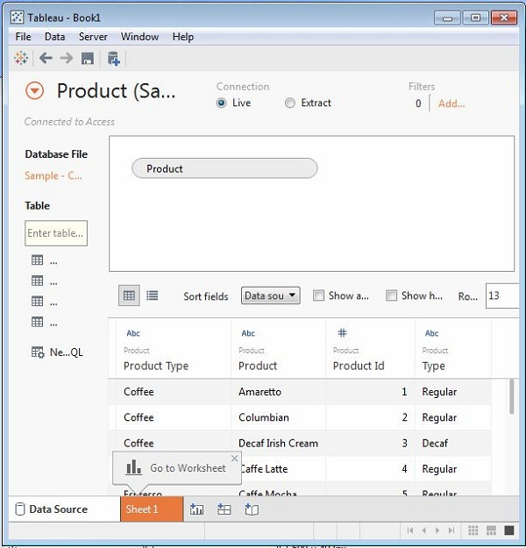
Tableau - Editing Metadata
Changing the Data Type. You can change the datatype of some of the fields if required. ...
Renaming and Hiding. The column names can be changed by using the renaming option. ...
Column Alias. Each column of the data source can be assigned an alias which helps better understand the nature of the column.

Slide 21
filter data
In Tableau, there are a variety of ways to filter your data. You can create a filter on a data source, you can implement a filter when you create an extract, you can filter dimensions, measures, and dates.
filter data sources
To create a data source filter on a worksheet, right-click (control-click on a Mac) the data source and choose Edit Data Source Filters. Whether you start from the Data Source page or from a worksheet, you see an Edit Data Source Filter dialog box, listing any existing data source filters.

Slide 22
Types of Charts
Area Chart. Steps to Create. ...
Bar Chart. Steps to Create. ...
3. Box and Whisker Plots. Steps to Create. ...
Bullet Chart. (we can use bullet charts to show the performance between measures. ...
Scatter Plot. ...
Pie Chart. ...
Bubble Chart. ...
Line Chart.

Slide 23
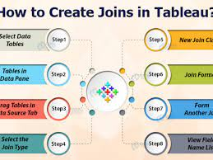

Slide 24
Data blending
Data blending in Tableau is the operation of combining multiple data sources into the same view by finding common fields between them to join on.

Slide 25
Apply filter on chart and data
Use your tableau.com(Link opens in a new window) account to sign in.
Filtering Order of Operations.
Select to keep or exclude data points in your view.
Select headers to filter data.
Drag dimensions, measures, and date fields to the Filters shelf.
Display interactive filters in the view.

Slide 26
data extract
A Tableau data extract is a compressed snapshot of data stored on disk and loaded into memory as required to render a Tableau viz. ... The second key aspect of TDE design is how they are structured which impacts how they are loaded into memory and used by Tableau

Slide 27
add a filter in tableau
To apply a filter to select worksheets:
On the Filters shelf, right-click the field and select Apply to Worksheets > Selected Worksheets.
In the Apply Filter to Worksheets dialog box, select the worksheets that you want to apply the filter.

Slide 28
Number functions
Function | Syntax
SIGN | SIGN(number)
SIN | SIN(number)
SQRT | SQRT(number)
SQUARE | SQUARE(number)

Slide 29
String functions
String functions allow you to manipulate string data (i.e. data made of text). For example, you might have a field that contains all of your customers' first and last names. ... You can pull the last names from all your customers into a new field using a string function.

Slide 30
Thank You

